Slide 1
Spatial Area Skyline Query
Group 8:
Vedang Parasnis
Atul Ahire
Manpreet Kaur

Slide 2
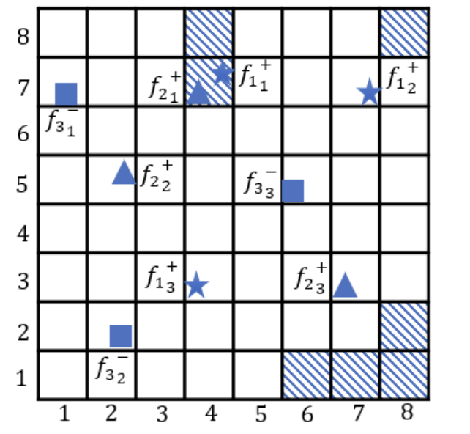
Application Overview
Grid Based Area Skyline
Problem Statement:
Given n × n small square grids G = {g1,1, ..., gn,n}.
A grid gi is said to dominate another grid gj in a map if distance to the nearest favourable place from gi is smaller than that of gj and distance to the nearest unfavourable place from gi is larger than that of gj.
Favourable Places (q < gi and q > gj). (q is the sample query point inside the grid)
Unfavourable Places (q > gi and q < gj) (q is the sample query point inside the grid) .
Factors considered:
Categories of Facilities
Favourable.
UnFavourable.
Spatial Grid Size.
Types of facilities belonging to a same category.
Number of objects / spatial locations for each type of facility.
Notes:
The factors considered are the points used to describe the spatial scalability of the grid application.

Slide 3
Overall Parallelization Strategy
1. Decomposition Pattern: Task driven Data decomposition.
A Facility type belonging to any type of category determines the task, which can run independently covering its spatial objects locations.
Dependency Analysis: Independent Execution
Skyline objects for a facility type are computed independently.
Requires collective communication at the end to compute the global skyline objects for all facilities.
Results consider filtering based on category, we remove points that are closer to unfavourable locations.
Algorithmic Structure: Divide and Conquer
Tasks determine the divide work for computing local skyline respective to a facility type, conquer combines all the local skylines to provide global skyline objects for the entire grid.
Fundamental Data Structure: Two Dimensional Spatial Grid (N * N).
Based on the implementations, the grid is processed in parallel denoting a geographical spatial place on the map.

Slide 4
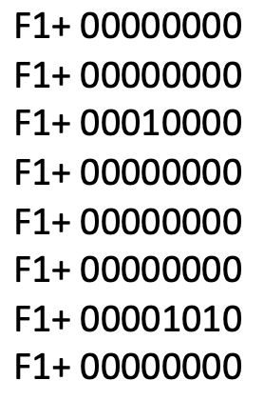
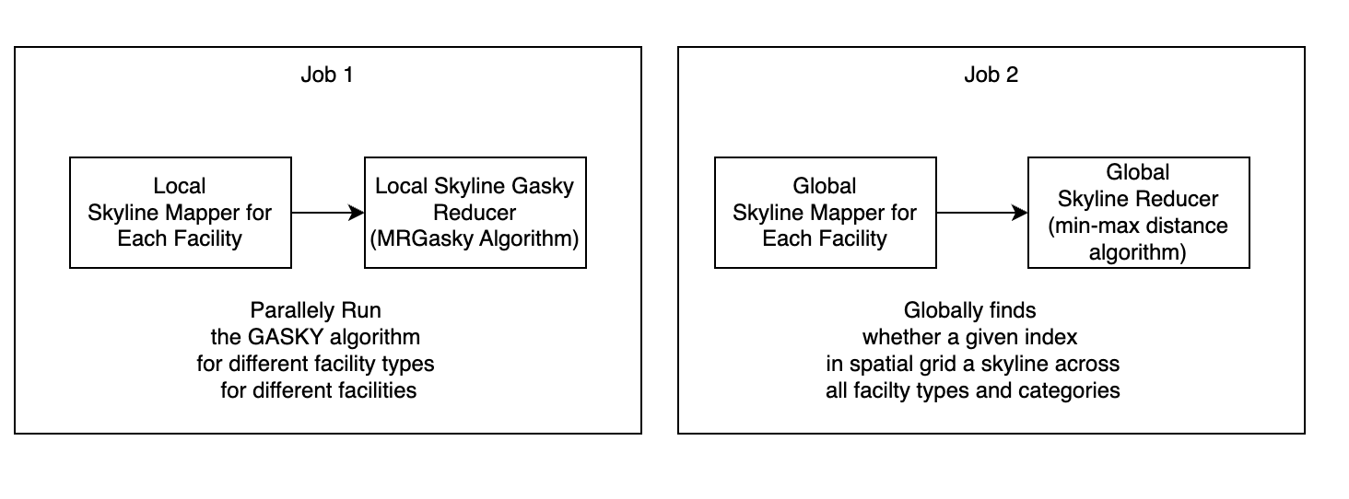
MapReduce Based Grid Area Skyline Algorithm (MRGASKY)
Using Proximity Intervals to calculate spatial dominance and MinMax Distance algorithm
Algorithm Flow:
Runtime Complexity:
Dominance Relation among points using Voronoi Polygons / Local Skyline( Θ(n), O (n^2) , used Deque, PriorityQueue construct Voronoi Polygons).
MinMax Distance Algorithm / Global Skyline ( Θ(n), O(n) ).*
Sequential Brute Force Runtime Complexity:
Each pair Euclidean distances across all points in 3d spatial grid O(n ^ 5).
Notes:
This slide has to be removed for final presentation.

Slide 5
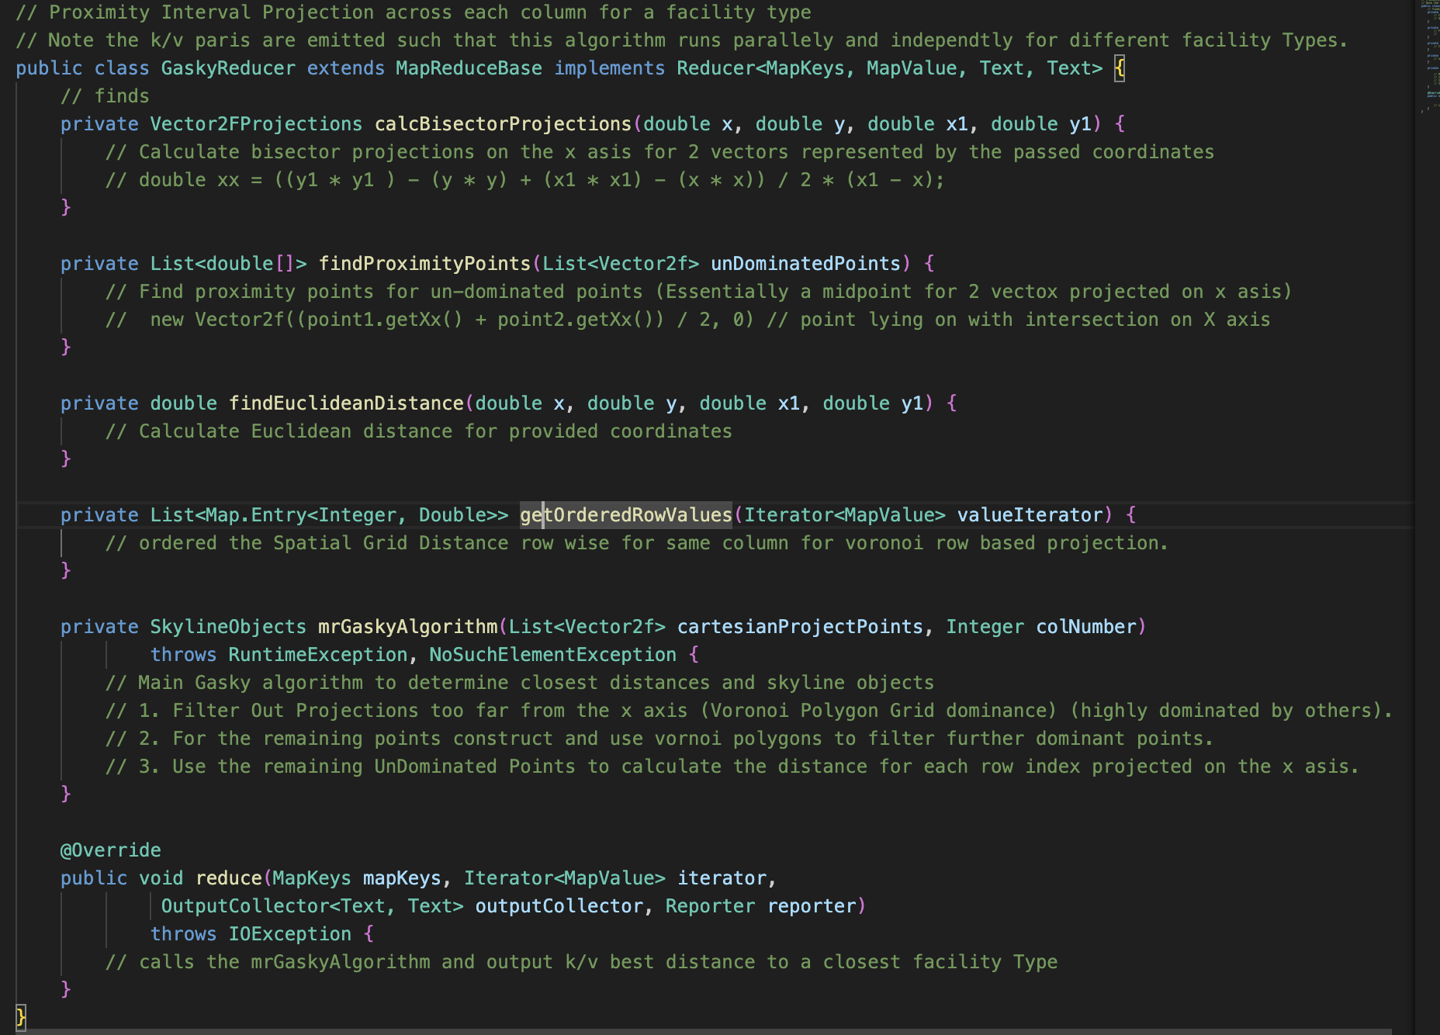
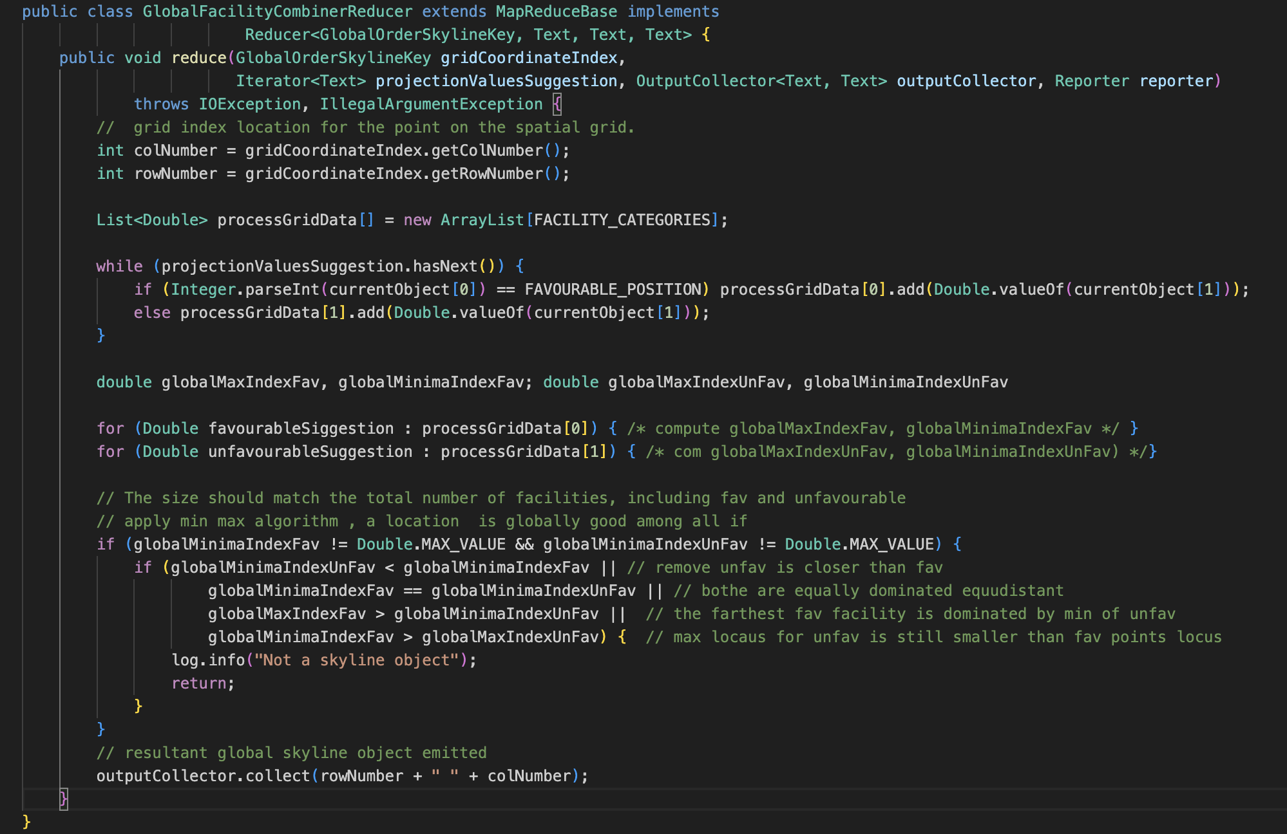
MapReduce
Notes:
This slide has to be removed for final presentation.

Slide 6
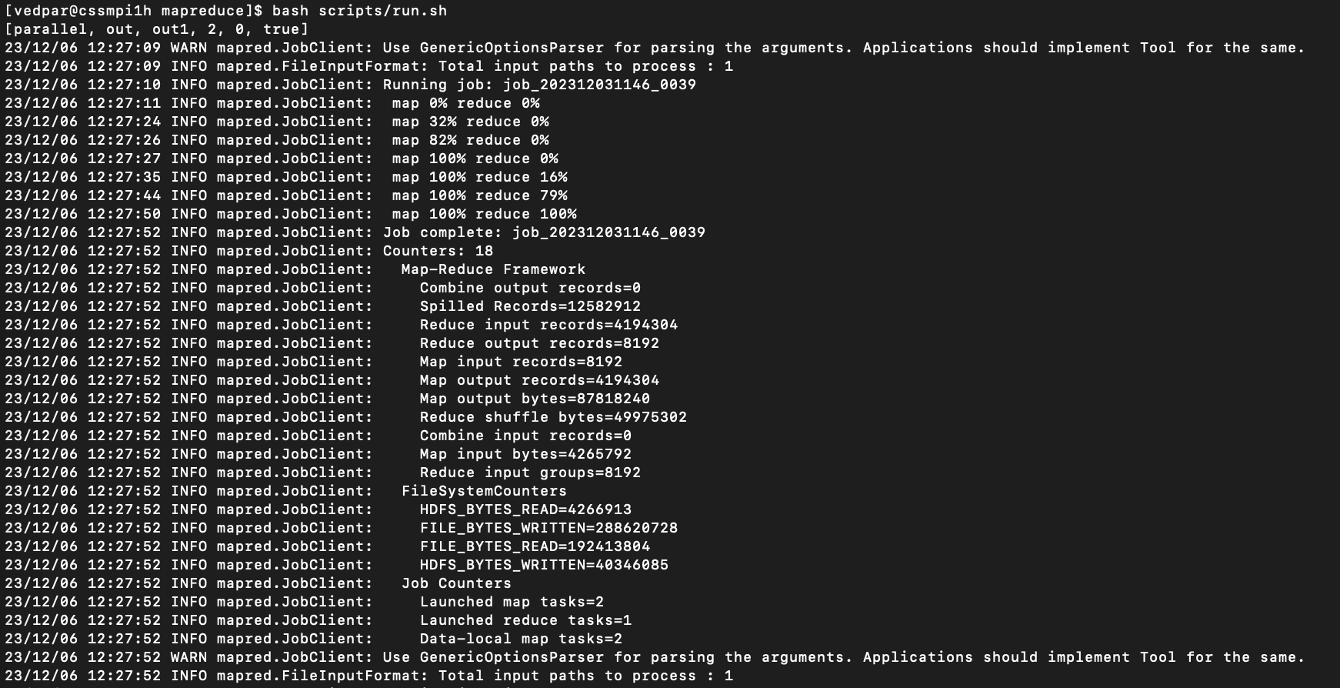
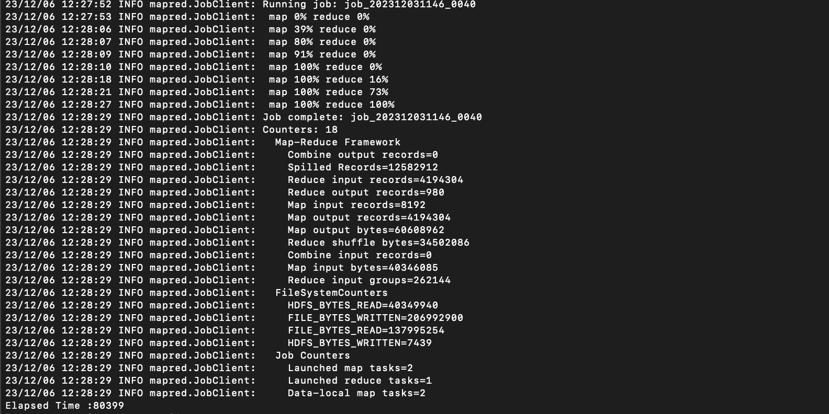
Mapreduce Execution Results
Grid Size: 512, Facility Count: 16, Facility Categories:2 Output Result for Benchmarks Hadoop Cluster Size: 4 Nodes

Slide 7
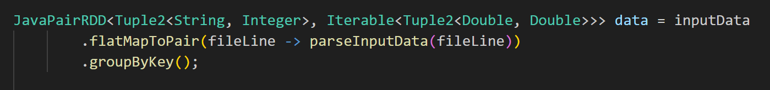
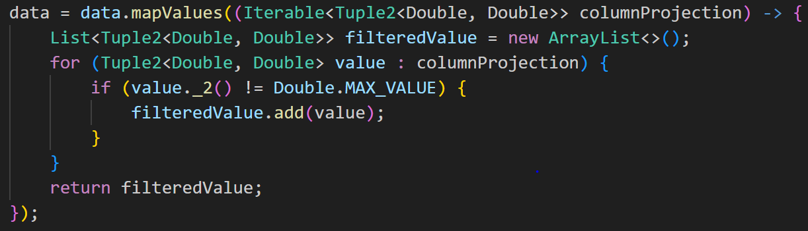
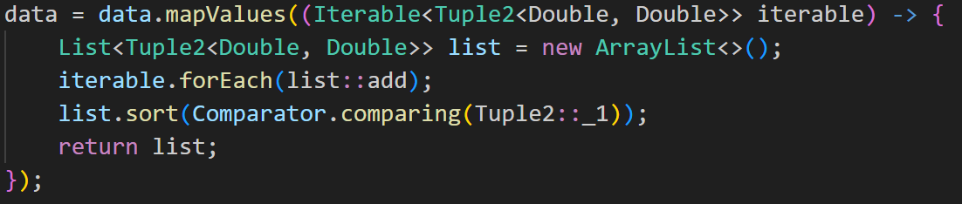
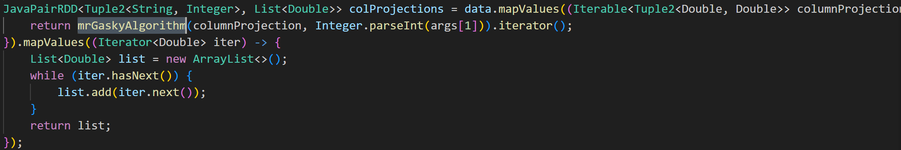
Spark
1. flatMapToPair Transformation:
Parse the Binary Matrix denoting spatial grid points on the map.
Data Filtering:Filters out values with the second element equal to Double.MAX_VALUE from each group.
2. mapValues Transformation:
Sort Based on x row projection
in the grid for a specific column
3. Applying MrGasky algorithm
Applies MrGasky Algorithm to
Each group and converts the
results to a List.

Slide 8
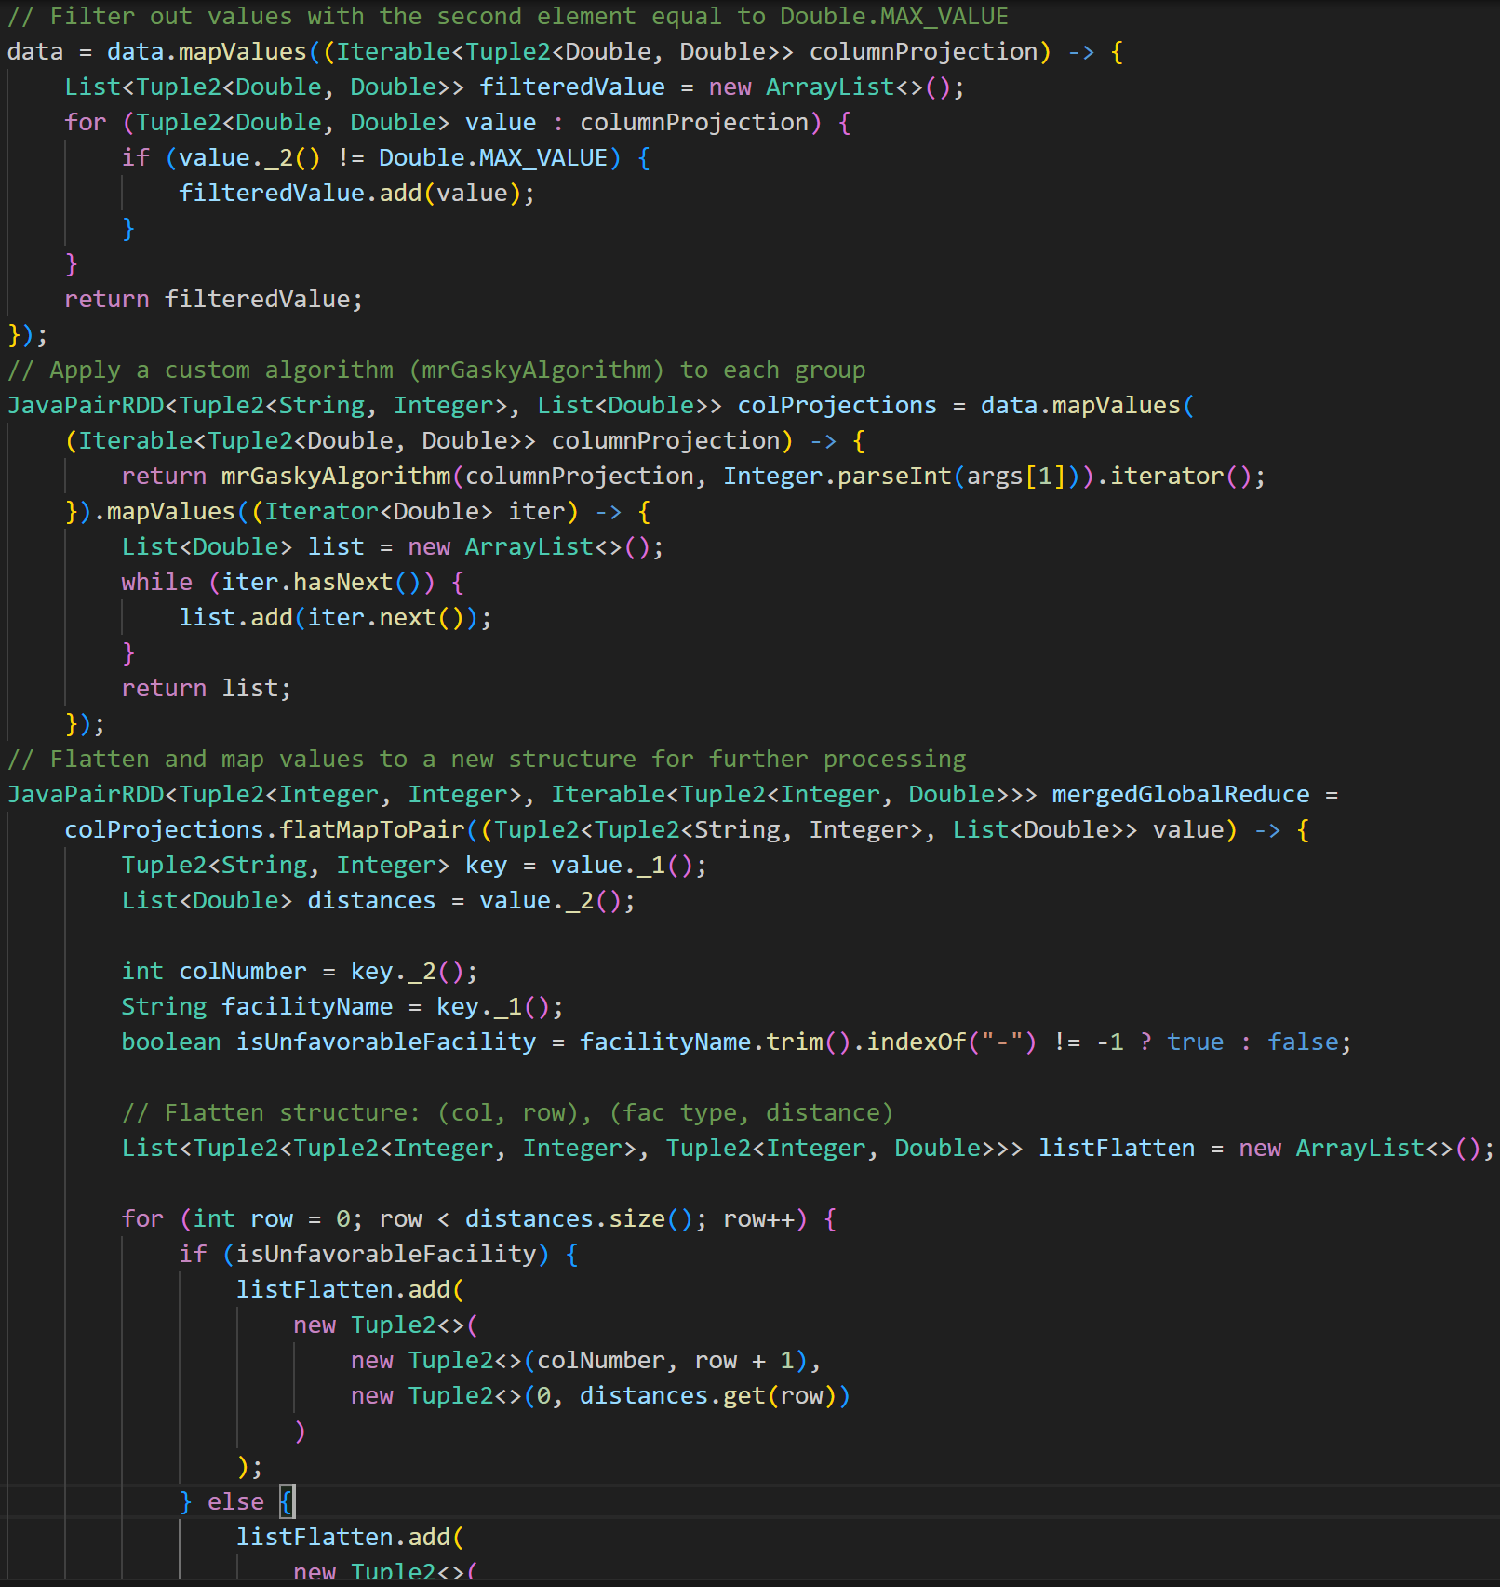
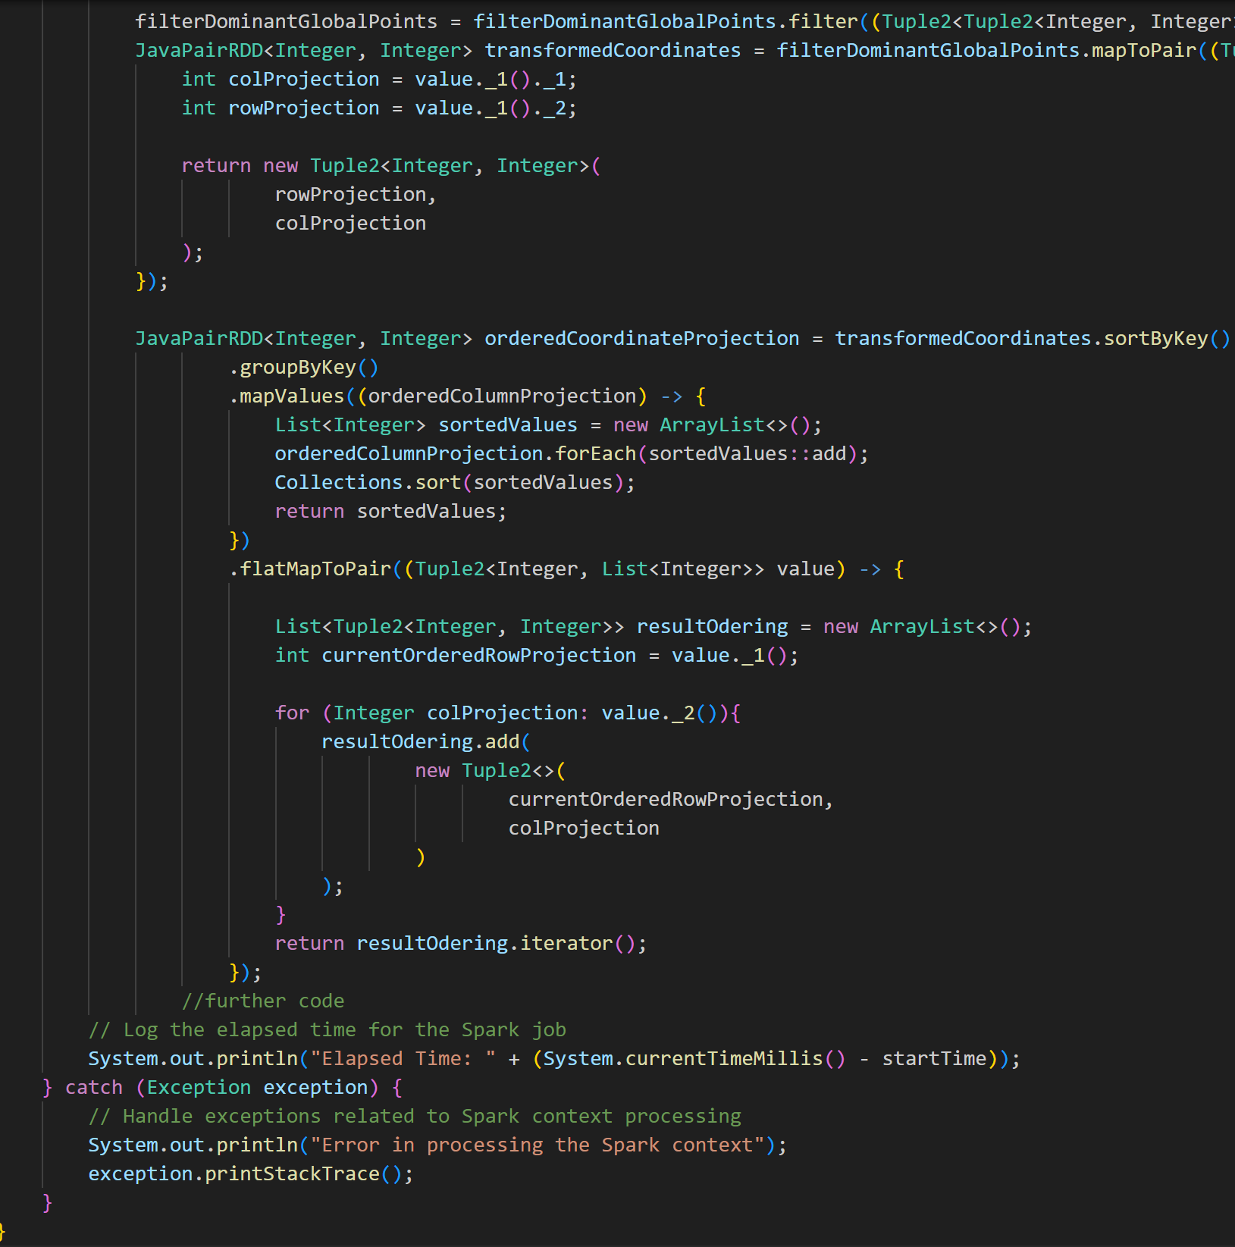
Spark

Slide 9
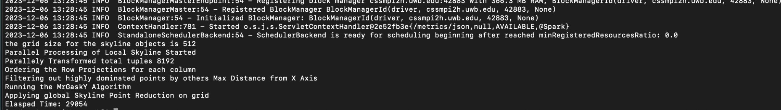
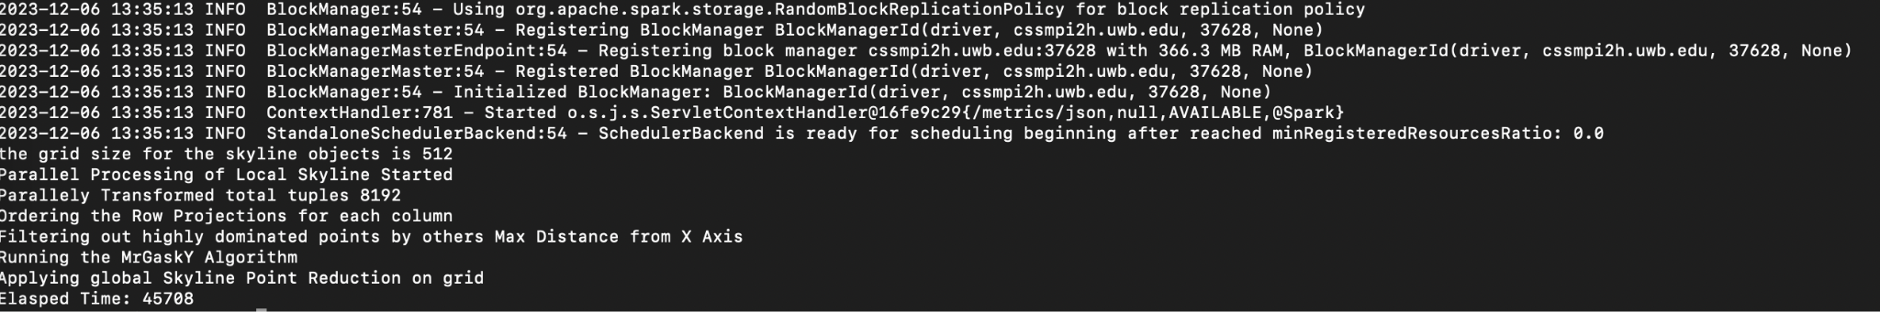
Spark Execution Runs
CLuster Size: 4 Nodes, Total CPU cores: 16, Total Memory: 59.1 gb Output Result for Benchmarks 16 cores and 8gb to spark job
8 cores and 4gb to spark job
More CPU cores and memory performance gain: 1.54
From further benchmarking this performance gain improves with an increase in Grid Size (Spatial Size Increase).

Slide 10
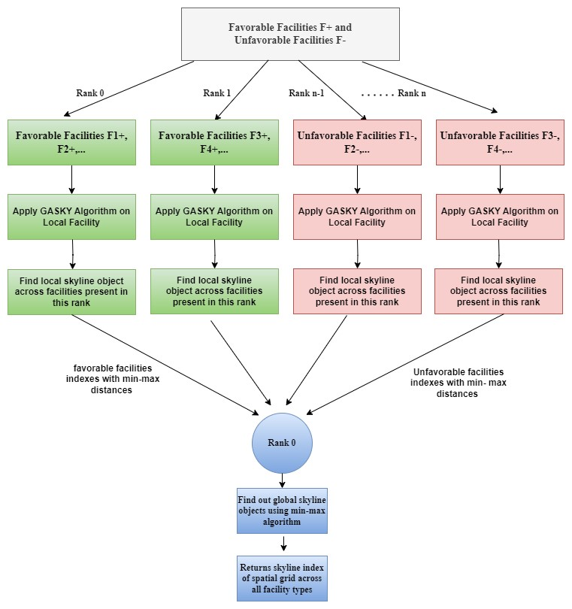
Parallelization strategy used in MPI
Runtime Complexity -
Gasky Algorithm / Local Skyline
(Θ(n^3), O (n^3))
Min-max algorithm -
(Θ(n), O (n))

Slide 11
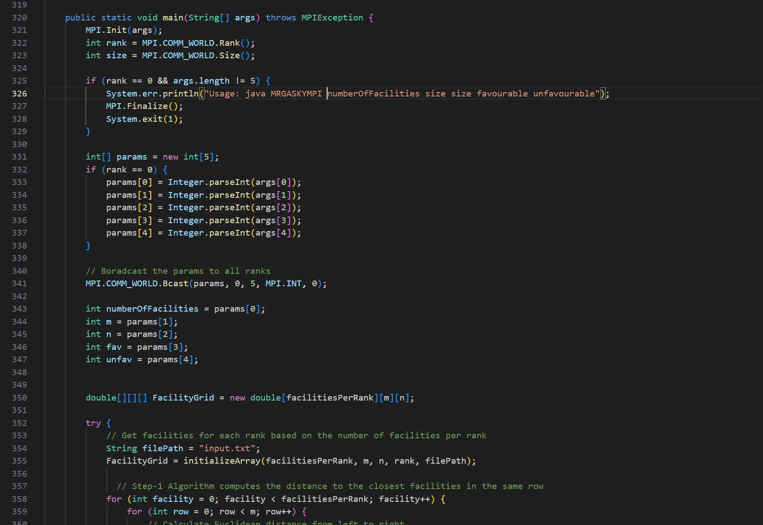
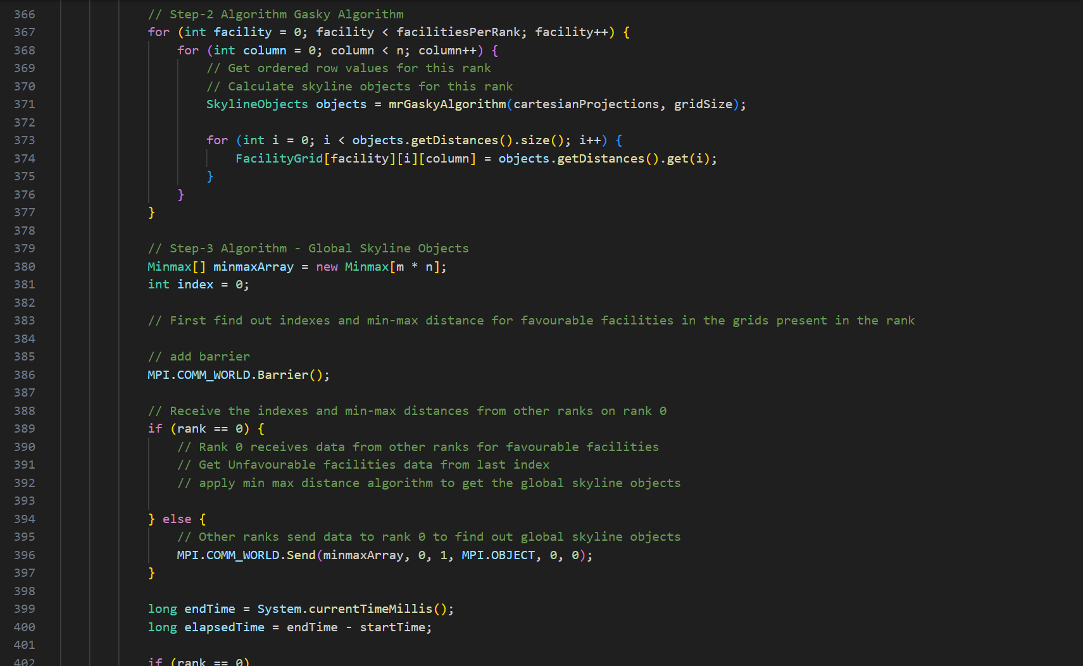
MPI

Slide 12
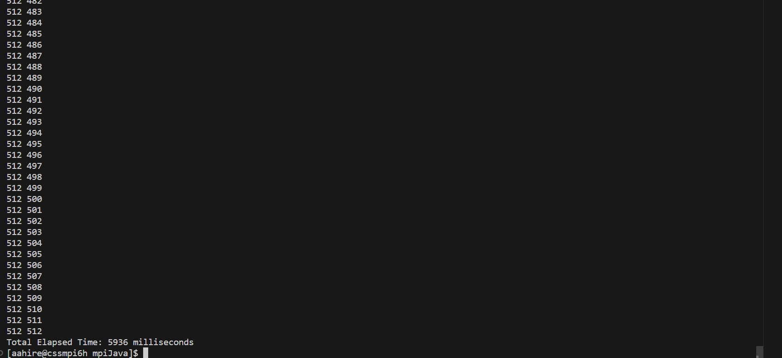
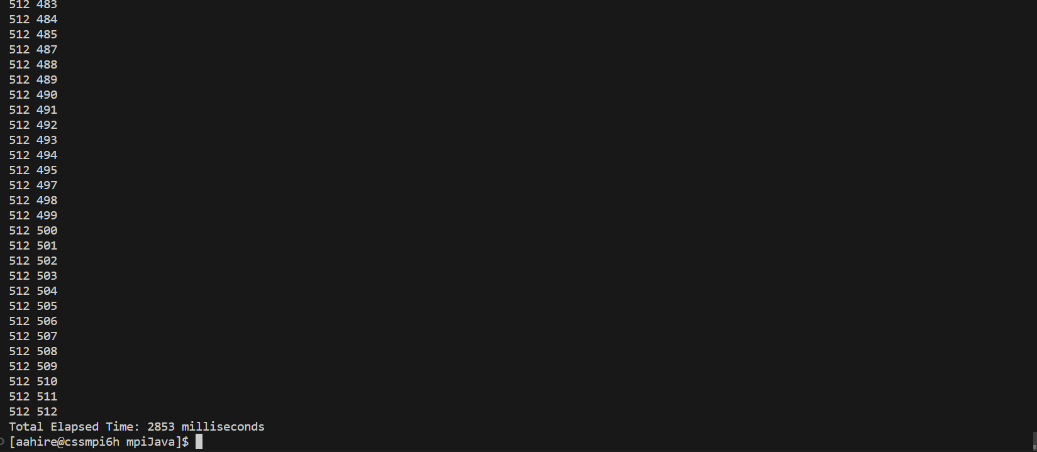
MPI Execution Results
Execution of facility types=16 and grid size= 512 across 2 ranks Output Result for Benchmarks
Execution result across 4 ranks with same input

Slide 13
Parallelization strategy used in MASS
For MASS we have only used places and no agents. Each place resembles a facility type.
Every Place holds information about the geospatial coordinates for the respective facility type.
Since Local Skyline computation is embarrassingly parallel, with task driven data decomposition (inner coordinates present in the extended place for MASS). We use places.callAll() with different stages in our algorithm to update associate places internal spatial grid in parallel.
All the places compute local skyline using dominance relation finding algorithm based on voronoi polygons.
For Global Skyline computation we have data dependency and cannot switch to data parallelism from task, hence we use places.callAll again to collect data across all the facilities / places and compute the global skyline at the master using min-max distance algorithm.
Notes:
Places: 3d grid MASS distributed to all the nodes
Place: Each Place in the grid is coordinates for a facility and positioning for that facility.
Agents:
Agents would be placed across each leftmost index of row and rightmost index of row.
Total Agents: 2 * row * number of facilities.
A agent moves across its allocated row in the grid
The same agent also moves across its allocated column in the grid.
As it moves it updates the value in the grid. (Agent State update when a facility encountered).

Slide 14
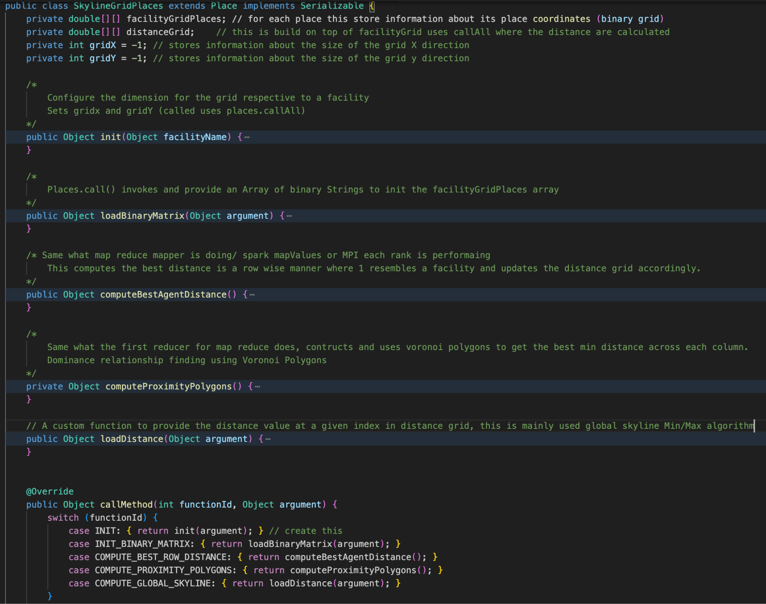
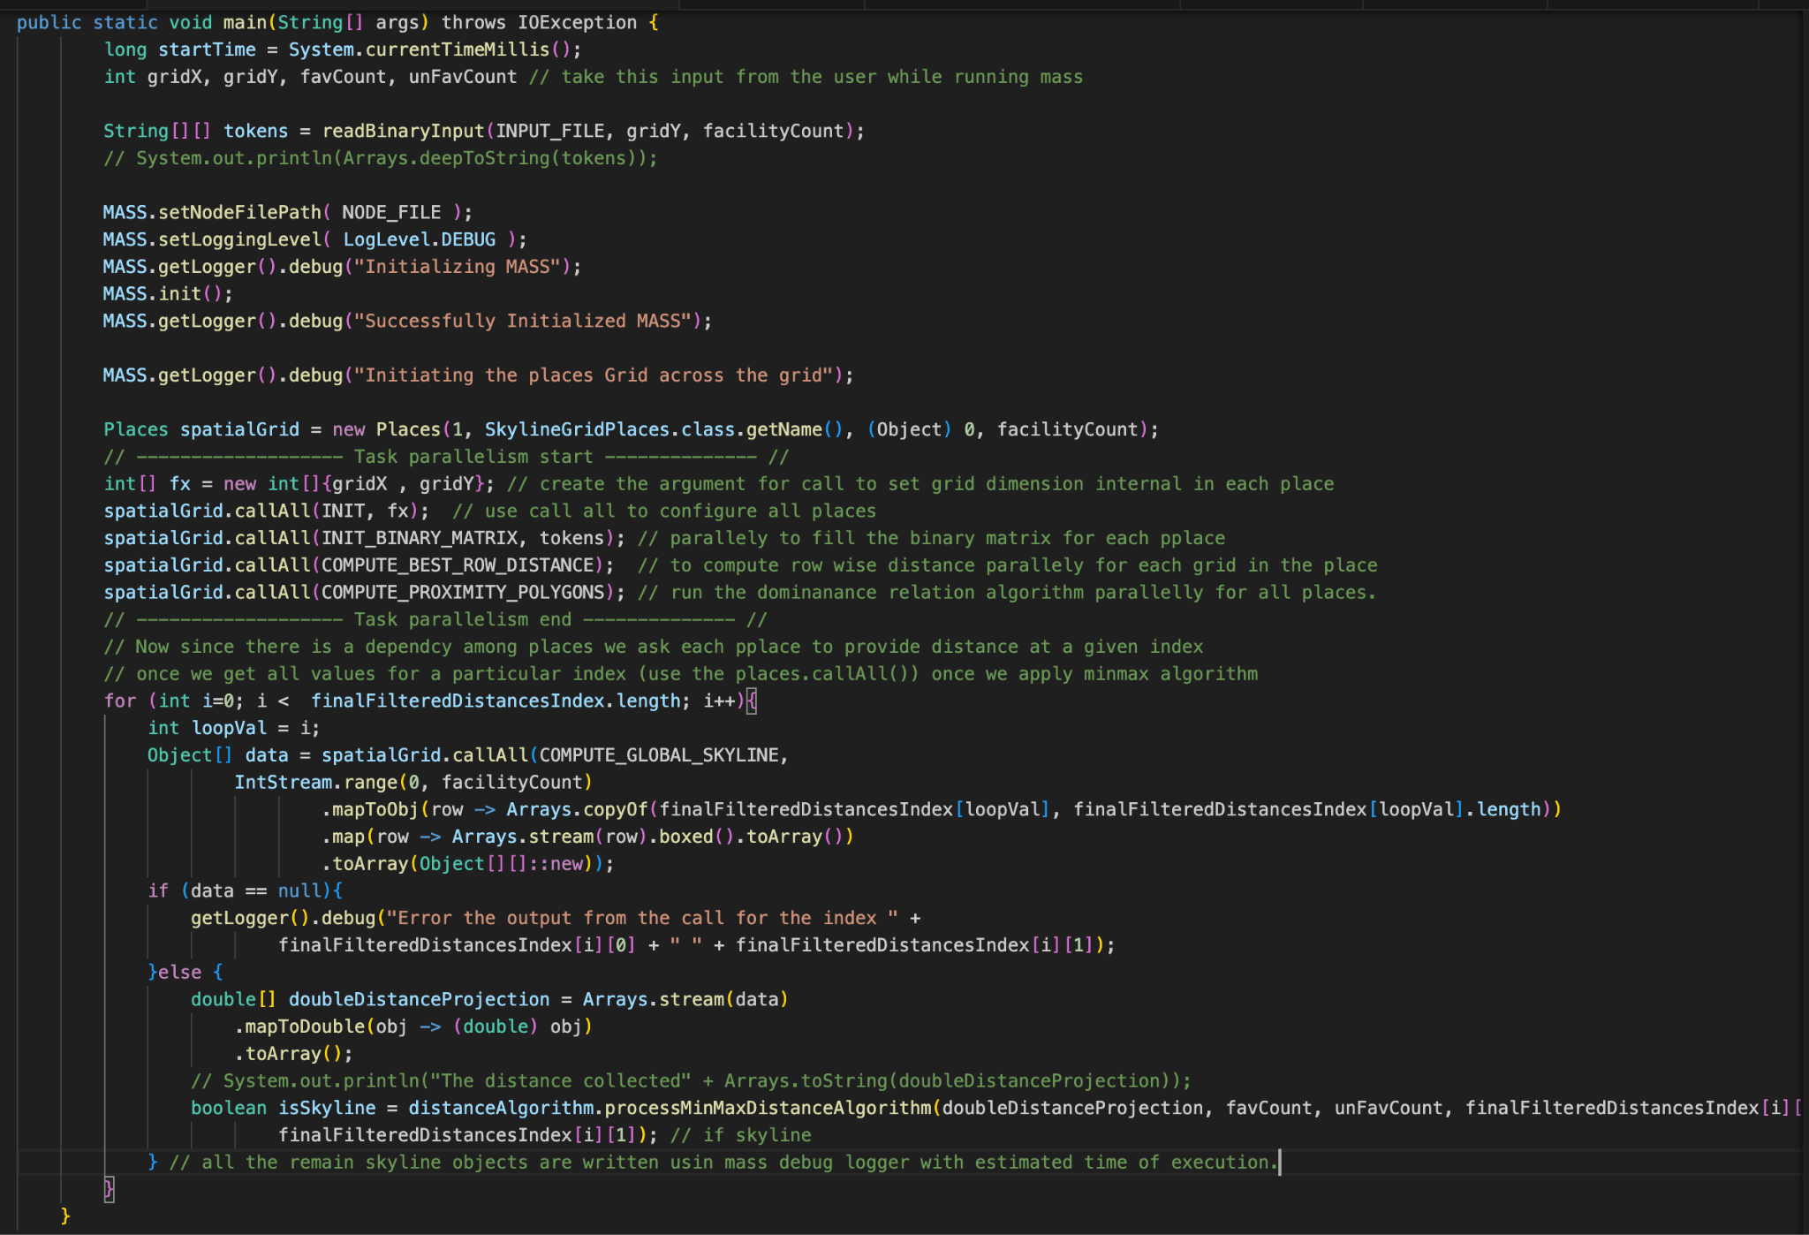
MASS
Notes:
Places: 3d grid MASS distributed to all the nodes
Place: Each Place in the grid is coordinates for a facility and positioning for that facility.
Agents:
Agents would be placed across each leftmost index of row and rightmost index of row.
Total Agents: 2 * row * number of facilities.
A agent moves across its allocated row in the grid
The same agent also moves across its allocated column in the grid.
As it moves it updates the value in the grid. (Agent State update when a facility encountered).

Slide 15
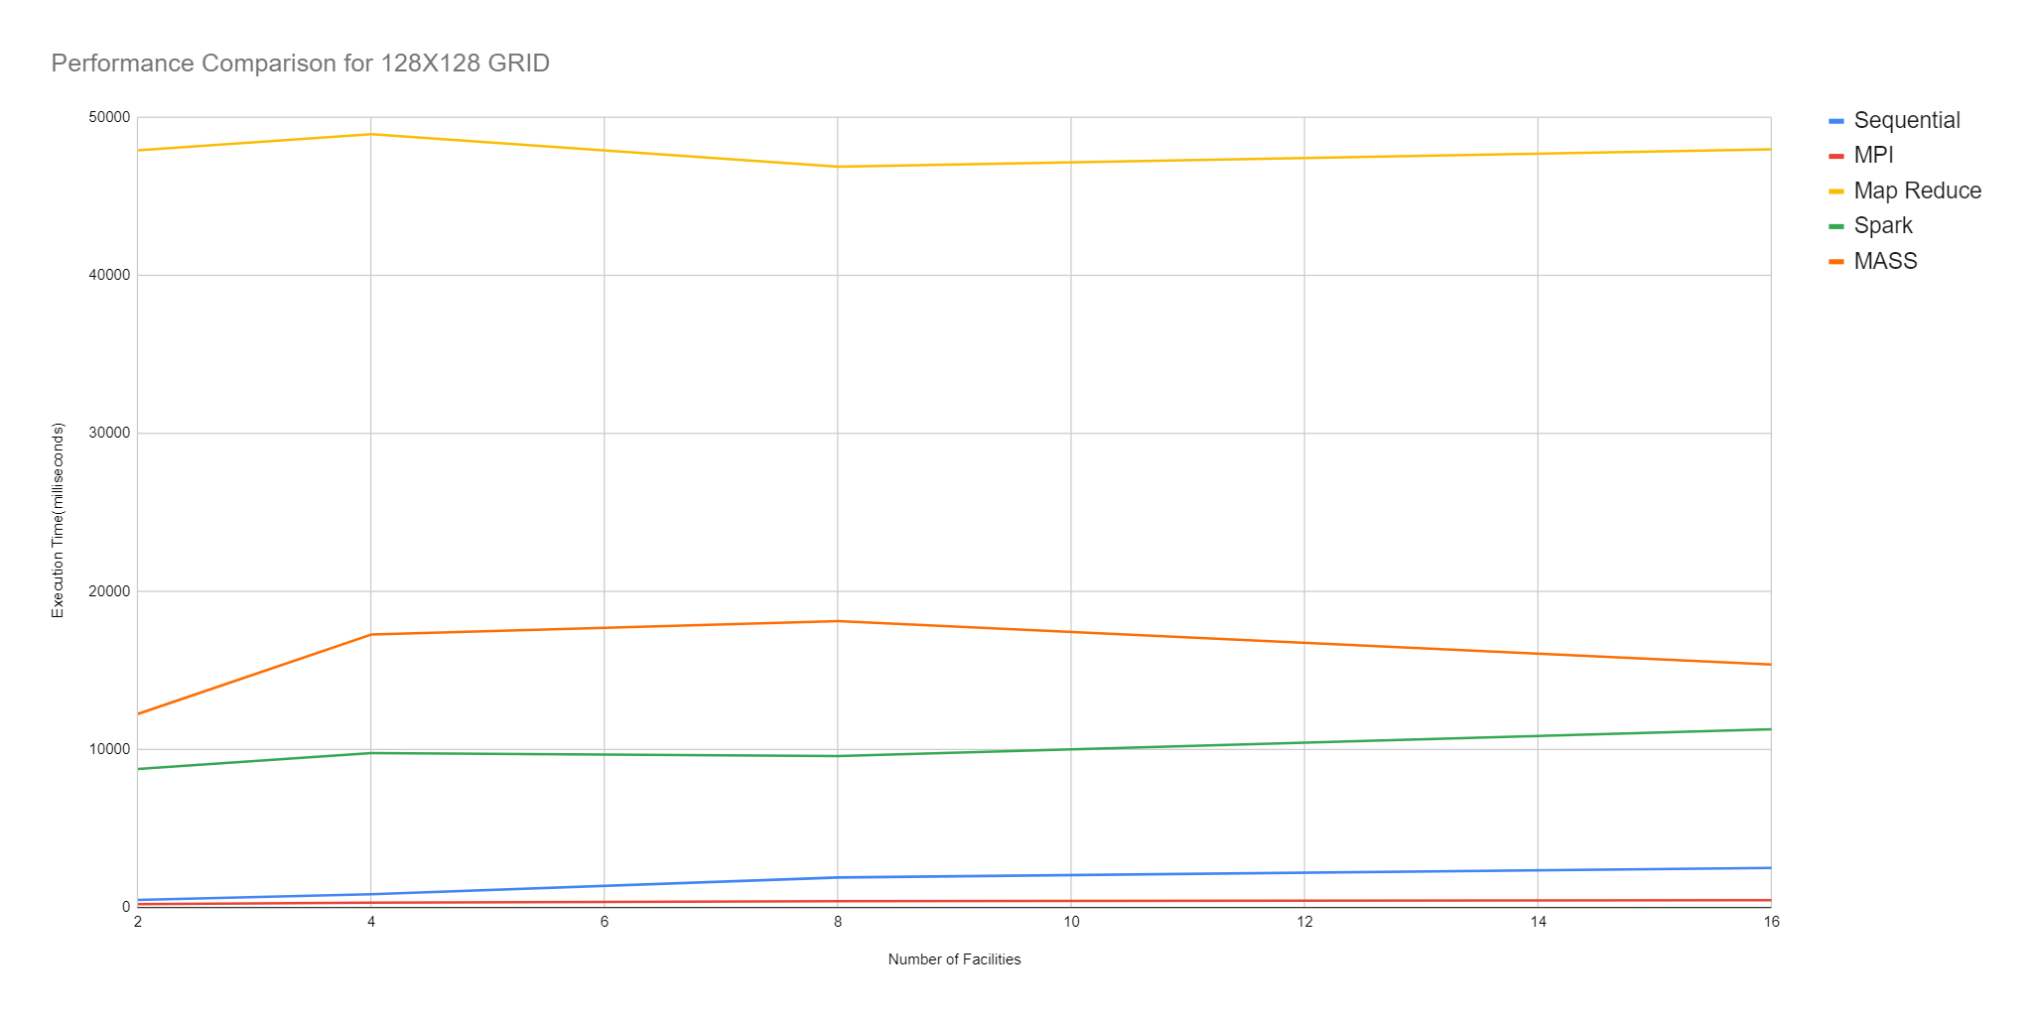
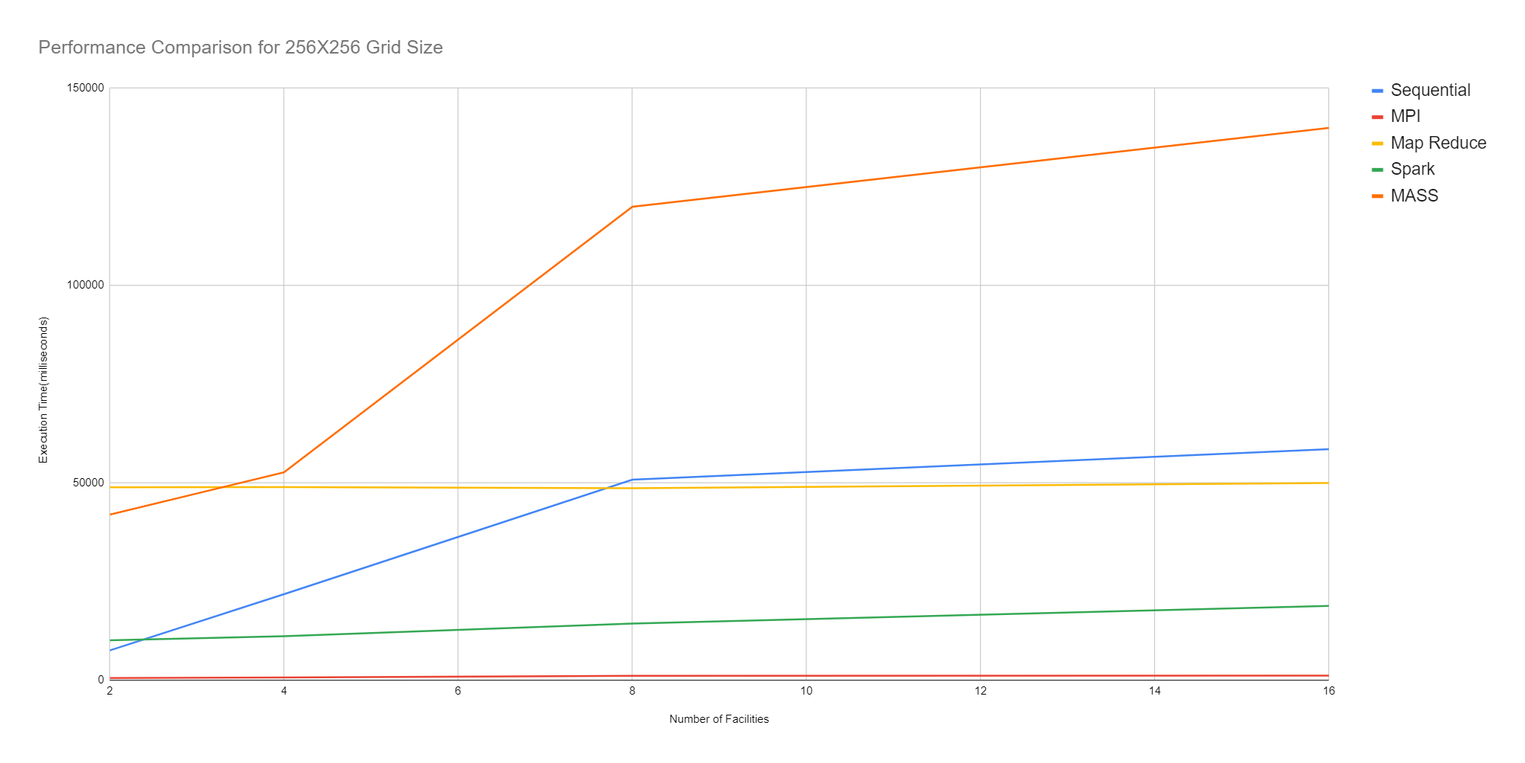
Performance Comparison
Spatial Scalability

Slide 16
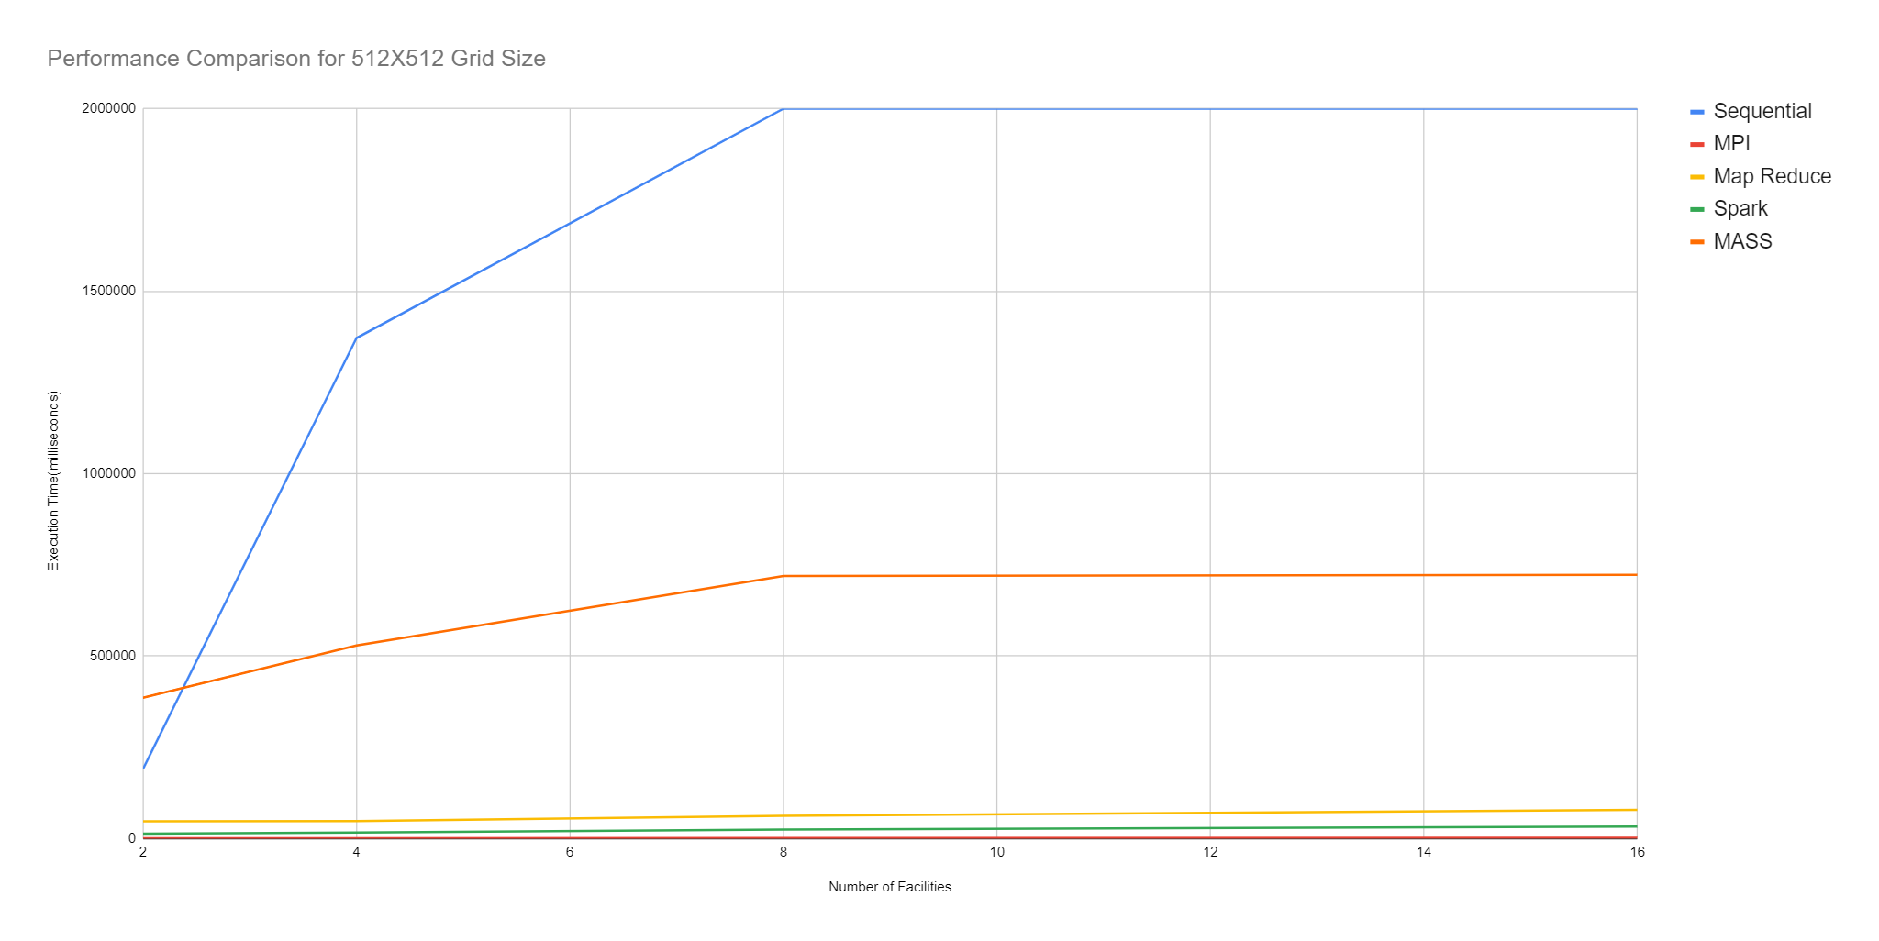
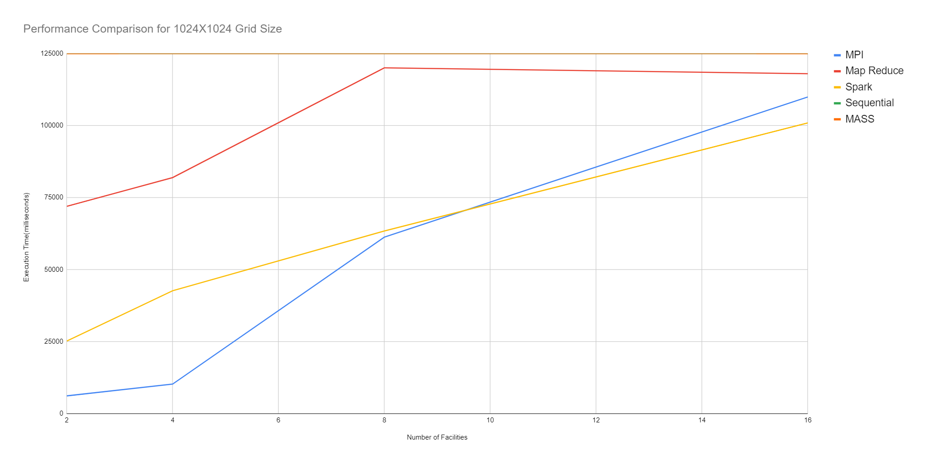
Performance Comparison
Spatial Scalability
Spatial Size Benchmarking

Slide 17
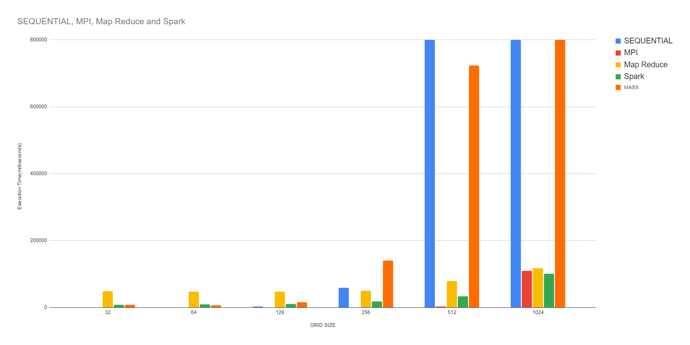
Performance Comparison
Spatial Scalability

Slide 18
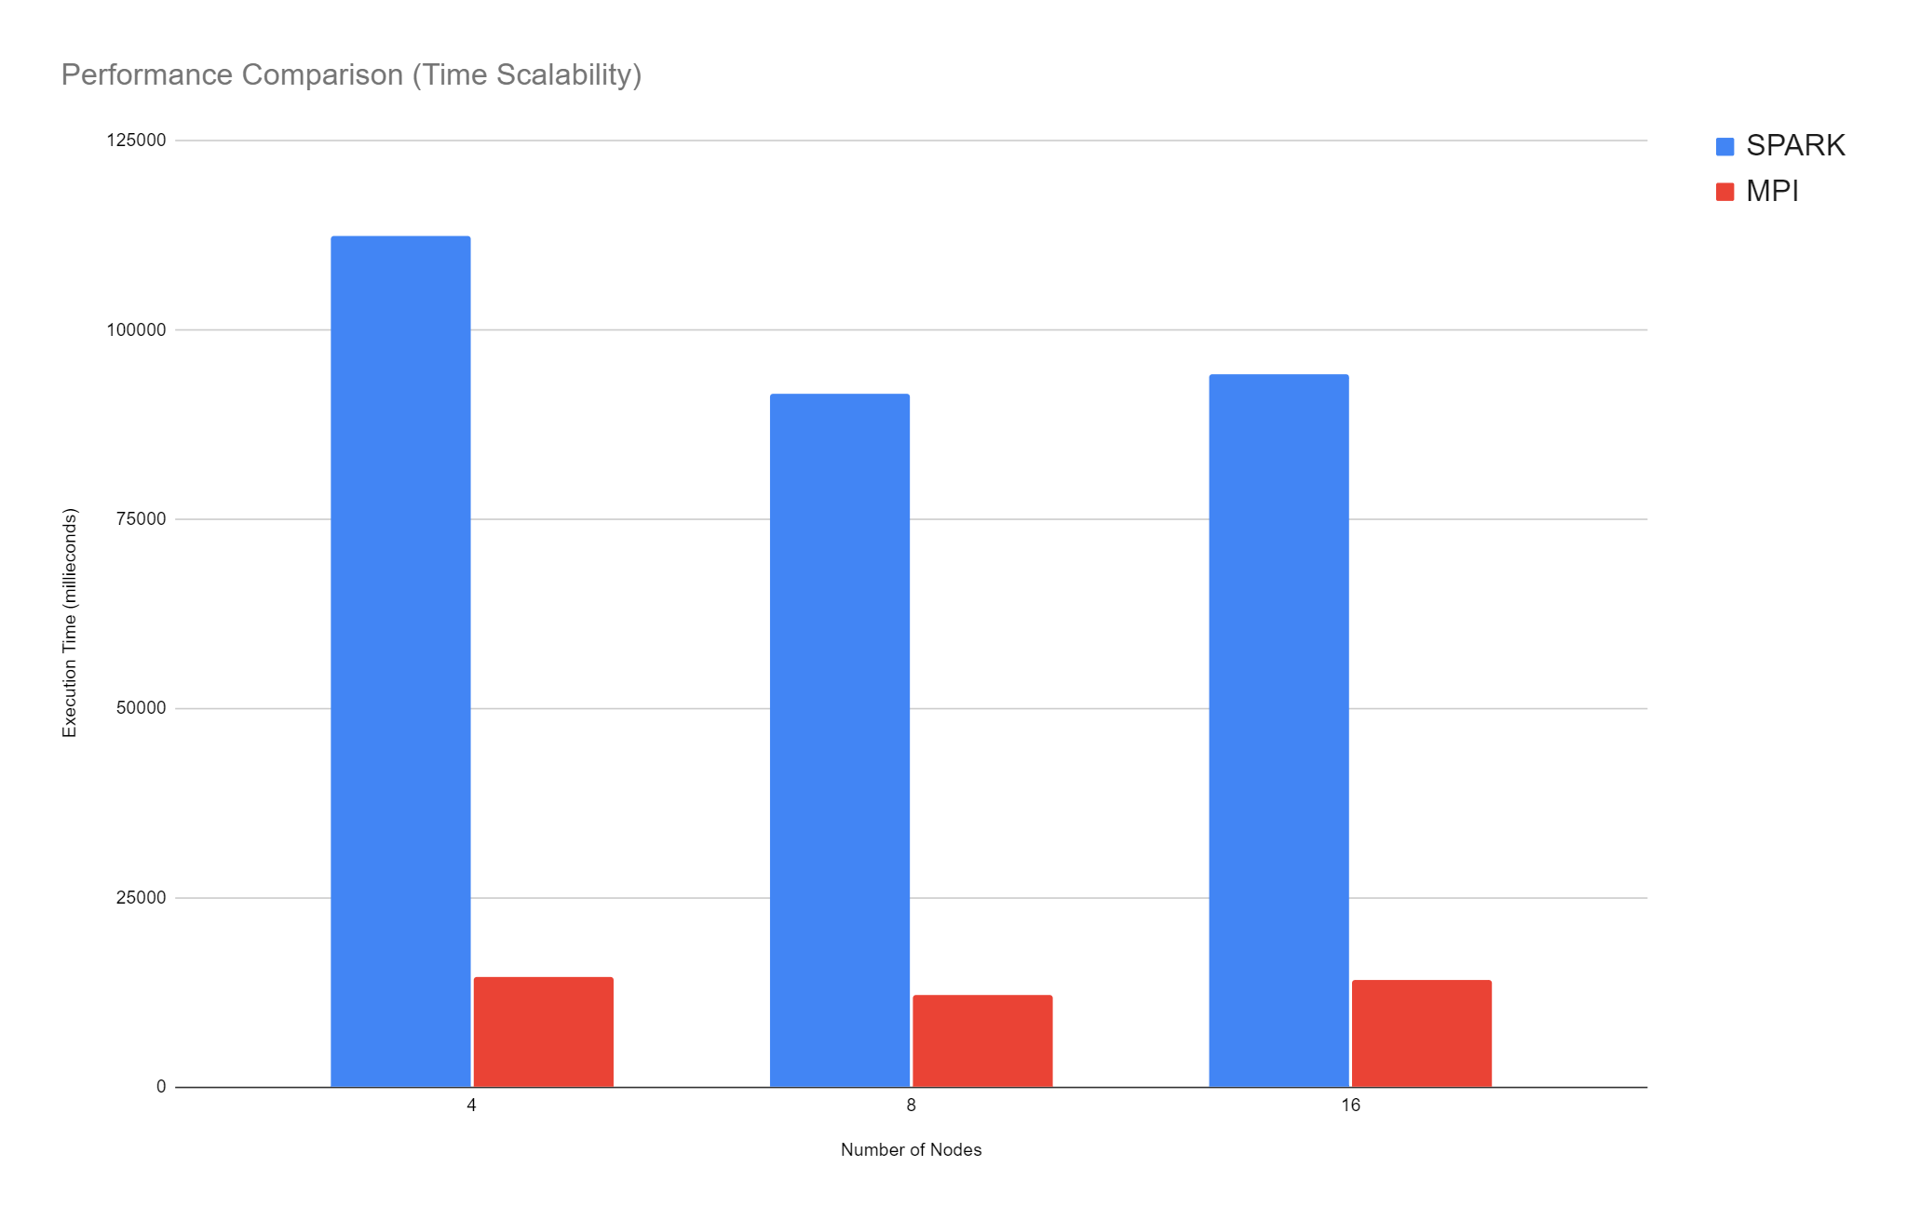
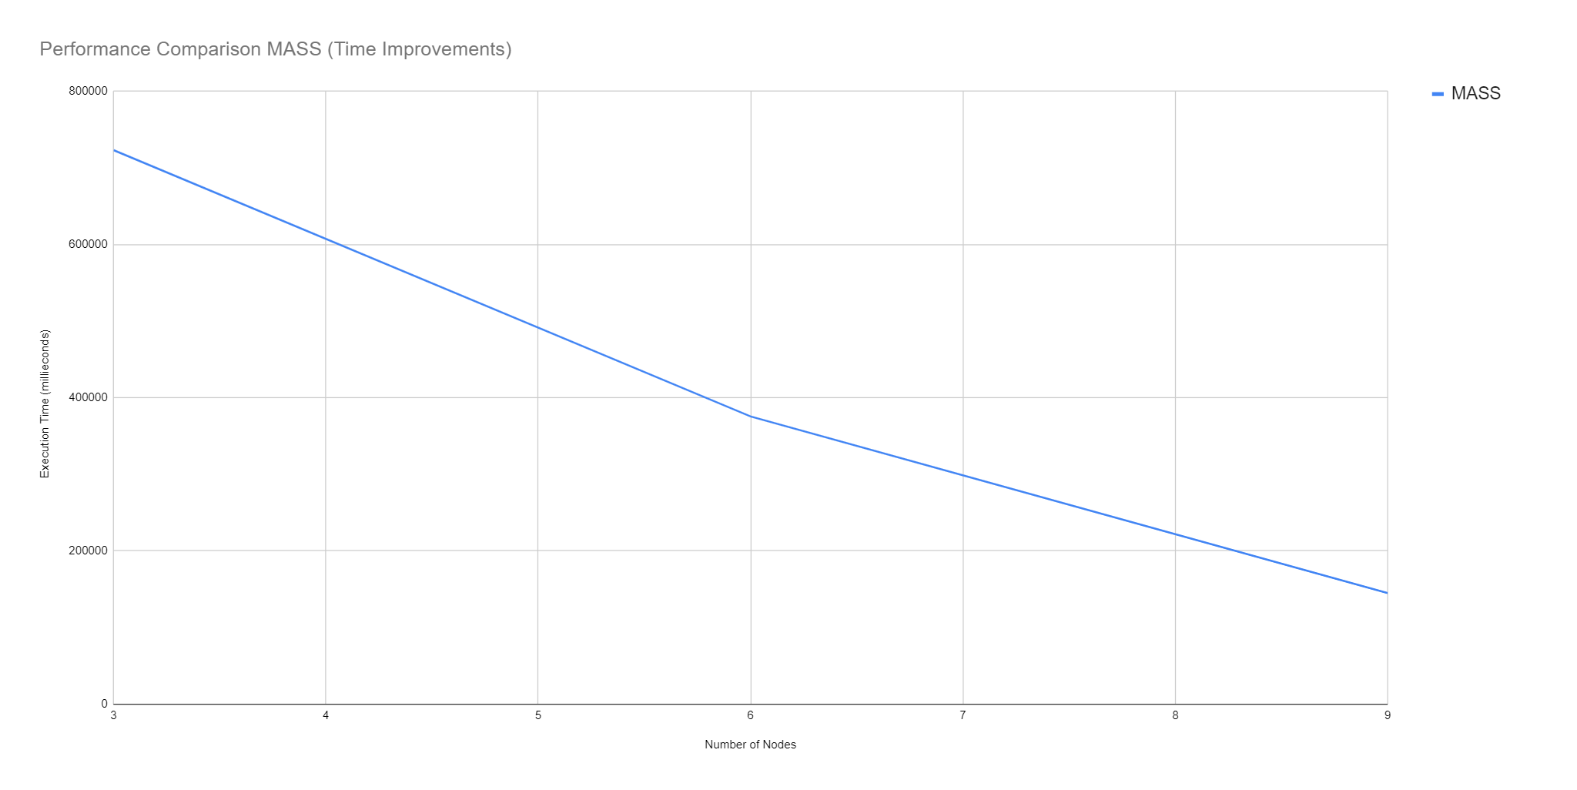
Performance Comparison
Time Improvements
Time Improvements Benchmark

Slide 19
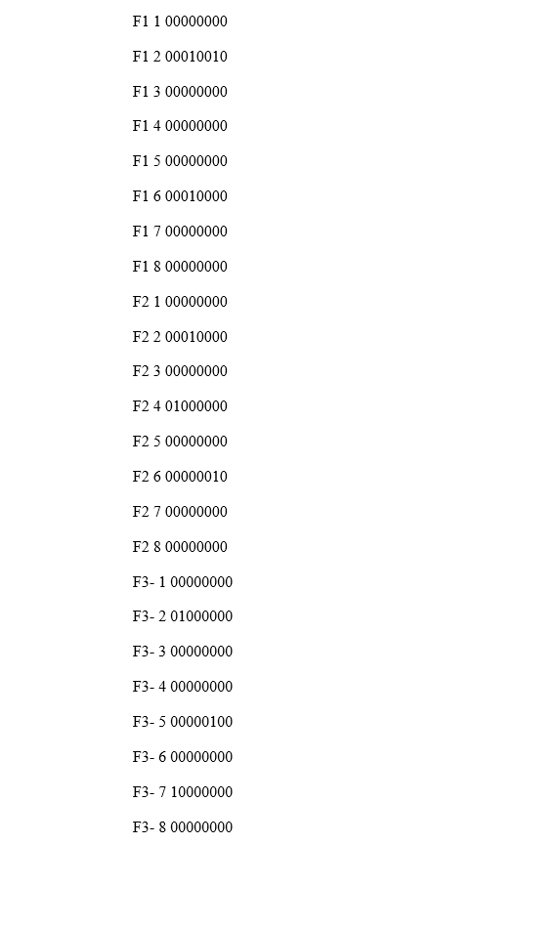
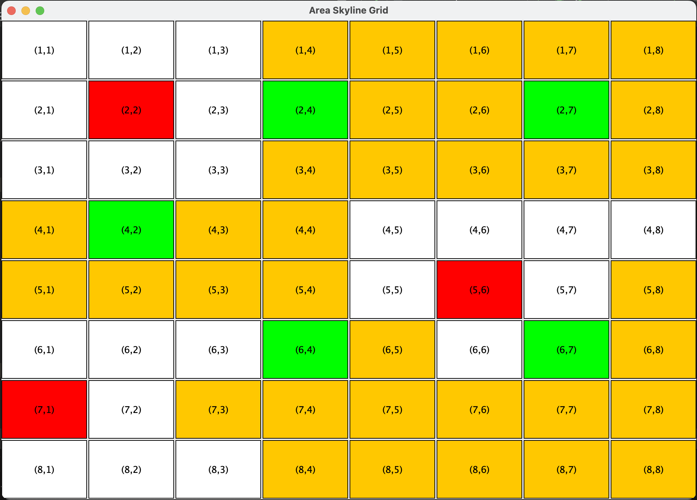
Custom build Skyline Grid Visualization GUI Tool

Slide 20
Programmability
 | Classes | LOC | Boilerplate % | Boilerplate Code | Cyclomatic Complexity
Sequential | 1 | 250 | 0 | 0 | 28
MPI | 4 | 600 | 0.005% | 2 | 99
Mapreduce | 16 | 800 | 11.5% | 187 | 52
Spark | 1 | 510 | 4.5% | 22 | 79
MASS | 5 | 800 | 4% | 25 | 73

